Slide 1

UNIT 5
FILE SYSTEM
FILE SYSTEM STRUCTURE

Slide 2
File System Structure
File system resides on secondary storage (disks)
File systems provide efficient and convenient access to the disk by allowing data to be stored, located, and retrieved easily.
I/O transfers between memory and disk are performed in units of blocks.
Each block has one or more sectors.
Sector size varies from 32 bytes to 4,096 bytes; the usual size is 512 bytes.
The file system itself is generally composed of many different levels.
Device driver controls the physical device

Slide 3
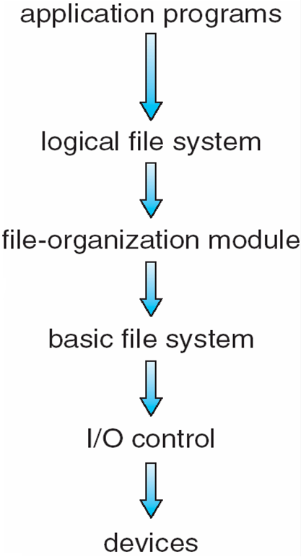
File System Structure
I/O Control Level
The I/O control level consists of device drivers to transfer information between the main memory and the disk system.
Its input consists of high-level commands such as “retrieve block 123.”
Its output consists of low-level, hardware-specific instructions that are used by the hardware controller.
Basic File System
It issues generic commands to the device driver to read and write physical blocks on the disk. For example retrieve block 123.
Each physical block is identified by its numeric disk address (for example, drive 1, cylinder 73, track 2, sector 10).
Also manages memory buffers and caches (allocation, freeing, replacement)
Buffers hold data in transit
Caches hold frequently used data

Slide 4
File System Structure
File Organization Module
It understands files, logical address, and physical blocks.
It translates logical block addresses to physical block addresses
Manages free space using free space manager, disk allocation
Logical File System
It manages metadata information.
Metadata includes all of the file-system structure except the actual data.
It manages the directory structure to provide the file-organization module with the information.
It maintains file structure via file-control blocks.
A file control block (FCB) (an inode in UNIX file systems) contains information about the file, including ownership, permissions, and location of the file contents.
Responsible for protection.

Slide 5
File System Structure
Layering useful for reducing complexity and redundancy.
But adds overhead and can decrease performance.
Many file systems, sometimes many within an operating system
Each with its own format (CD-ROM is ISO 9660;
Unix has UFS, FFS;
Windows has FAT, FAT32, NTFS as well as floppy, CD, DVD Blu-ray.
Linux has more than 40 types, with extended file system ext2 and ext3 leading; plus distributed file systems, etc.)
New ones still arriving – ZFS, GoogleFS, Oracle ASM, FUSE

Slide 6
File System Implementation
Implemented using on-disk and in-memory structures.
On disk, the file system may contain information about how to boot an operating system stored there, the total number of blocks, the number and location of free blocks, the directory structure, and individual files.
Boot Control Block
A boot control block can contain information needed by the system to boot an operating system from that volume.
It is typically the first block of a volume. In UFS, it is called the boot block. In NTFS, it is the partition boot sector.
Volume Control Block
It contains volume (or partition) details, such as
the number of blocks in the partition,
the size of the blocks,
a free-block count and free-block pointers, and
a free-FCB count and FCB pointers.
In UFS, this is called a superblock. In NTFS, it is stored in the master file table.

Slide 7
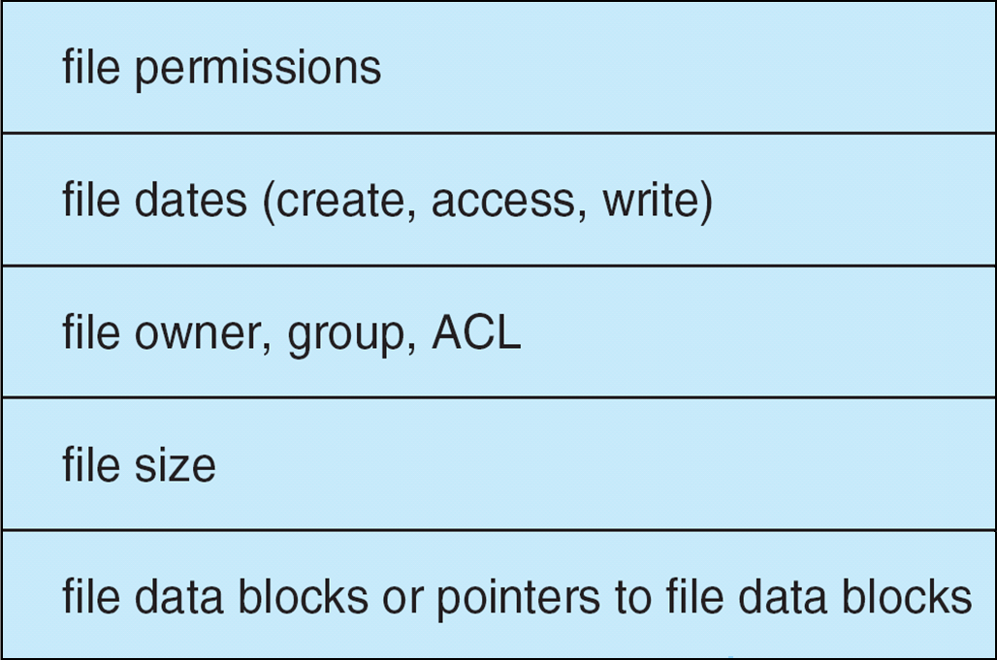
File System Implementation
A directory structure (per file system) is used to organize the files.
In UFS, this includes file names and associated inode numbers. In NTFS, it is stored in the master file table.
A per-file FCB contains many details about the file.

Slide 8
File System Implementation
The in-memory information is used for both file-system management and performance improvement via caching.
The data are loaded at mount time, updated during file-system operations, and discarded at dismount.
It has following datastructure,
An in-memory mount table contains information about each mounted volume.
An in-memory directory-structure cache holds the directory information of recently accessed directories. (For directories at which volumes are mounted, it can contain a pointer to the volume table.)
The system-wide open-file table contains a copy of the FCB of each open file, as well as other information.
The per-process open-file table contains a pointer to the appropriate entry in the system-wide open-file table, as well as other information.
Buffers hold file-system blocks when they are being read from disk or written to disk.

Slide 9
File System Implementation
To create a File,
To create a new file, logical file system allocates a new FCB.
The system then reads the appropriate directory into memory, updates it with the new file name and FCB, and writes it back to the disk
To Open file for read or write,
The open() call passes a file name to the logical file system.
The open() system call first searches the system-wide open-file table to see if the file is already in use by another process.
If it is, a per-process open-file table entry is created pointing to the existing system-wide open-file table.
If the file is not already open, the directory structure is searched for the given file name.
Once the file is found, the FCB is copied into a system-wide open-file table in memory.
This table not only stores the FCB but also tracks the number of processes that have the file open.

Slide 10
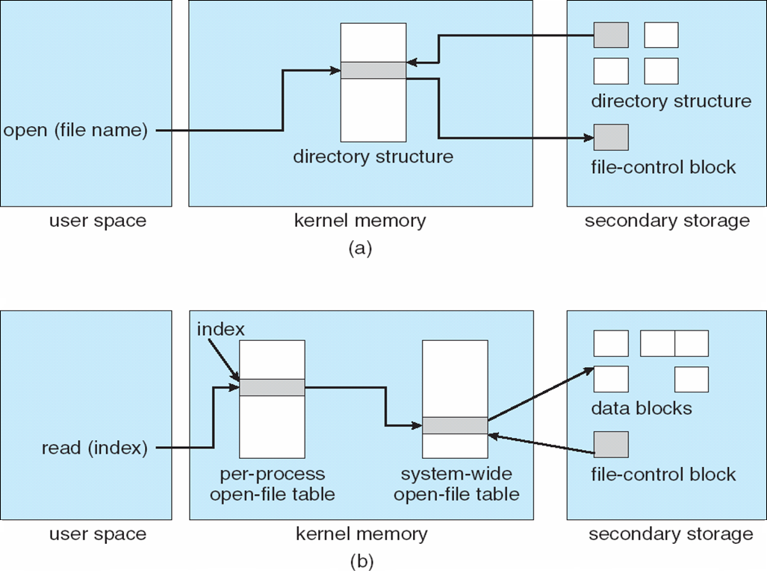
File System Implementation
In-memory file-system structures. (a) File open. (b) File read.

Slide 11
File System Implementation
To Read,
Next, an entry is made in the per-process open-file table, with a pointer to the entry in the system-wide open-file table and some other fields.
These other fields may include a pointer to the current location in the file (for the next read() or write() operation) and the access mode in which the file is open.
The open() call returns a pointer to the appropriate entry in the per-process file-system table.
All file operations are then performed via this pointer.
To Close
When a process closes the file, the per-process table entry is removed, and the system-wide entry’s open count is decremented.
When all users that have opened the file close it, any updated metadata is copied back to the disk-based directory structure, and the system-wide open-file table entry is removed.

Slide 12
THANK YOU

